Slide 1
ACCY577 Machine Learning for Accounting
Module 7: Introduction to Clustering
Linden Lu

Slide 2
Lesson 1: Introduction to K-means Clustering
K-means
Choose k centers randomly
Form k groups by centers
Recalculate centers of k groups
Repeat 2-4 until no change in groups or reach max_iter
Calculate total distance D
Repeat 1-6 pre-defined times(n_init)
Choose groups with smallest D as final clusters

Slide 3
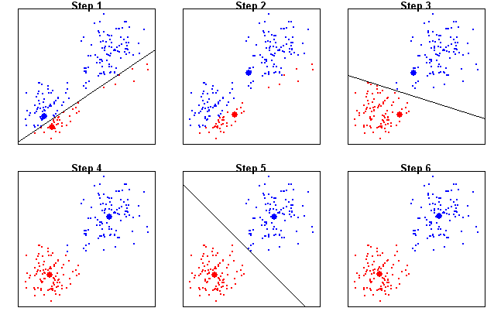
K-means (k=2)

Slide 4
Principal Component Analysis(PCA
Reduce Dimension
Retain major characteristics of original features
Help visualize clusters

Slide 5
Scikit Learn Kmeans Model
Standardize features
No train-test split
Hyperparameters
n_clusters: number of clusters, 𝑘
n_init: number of times to choose different initial centers, default 10.
max_iter: maximum number of iterations for the algorithm in any given run, default 300.
random_state: random seed, enables reproducibility.
Steps to apply KMeans
Create KMeans object with hyperparameter values
Fit with dataset
Predict dateset to get clusters

Slide 6
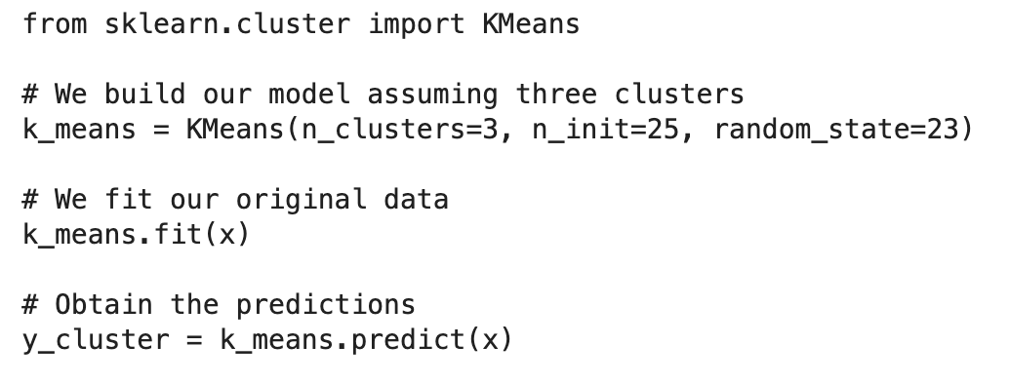
Scikit Learn Kmeans Model

Slide 7
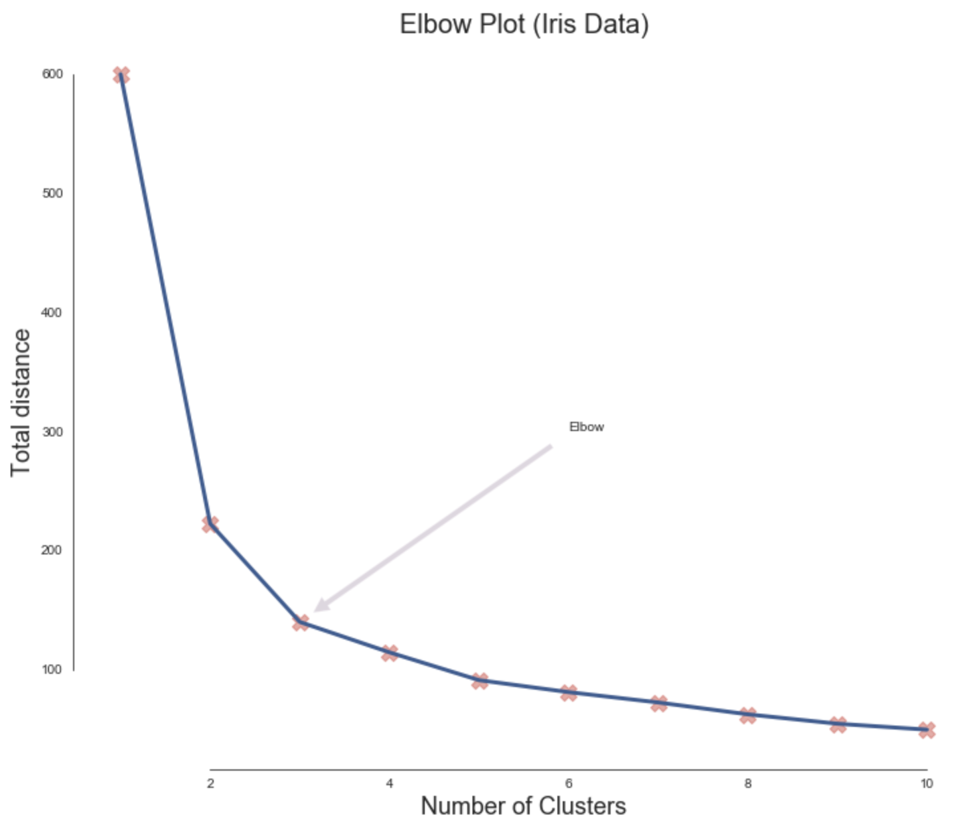
Determine K: Elbow Method

Slide 8
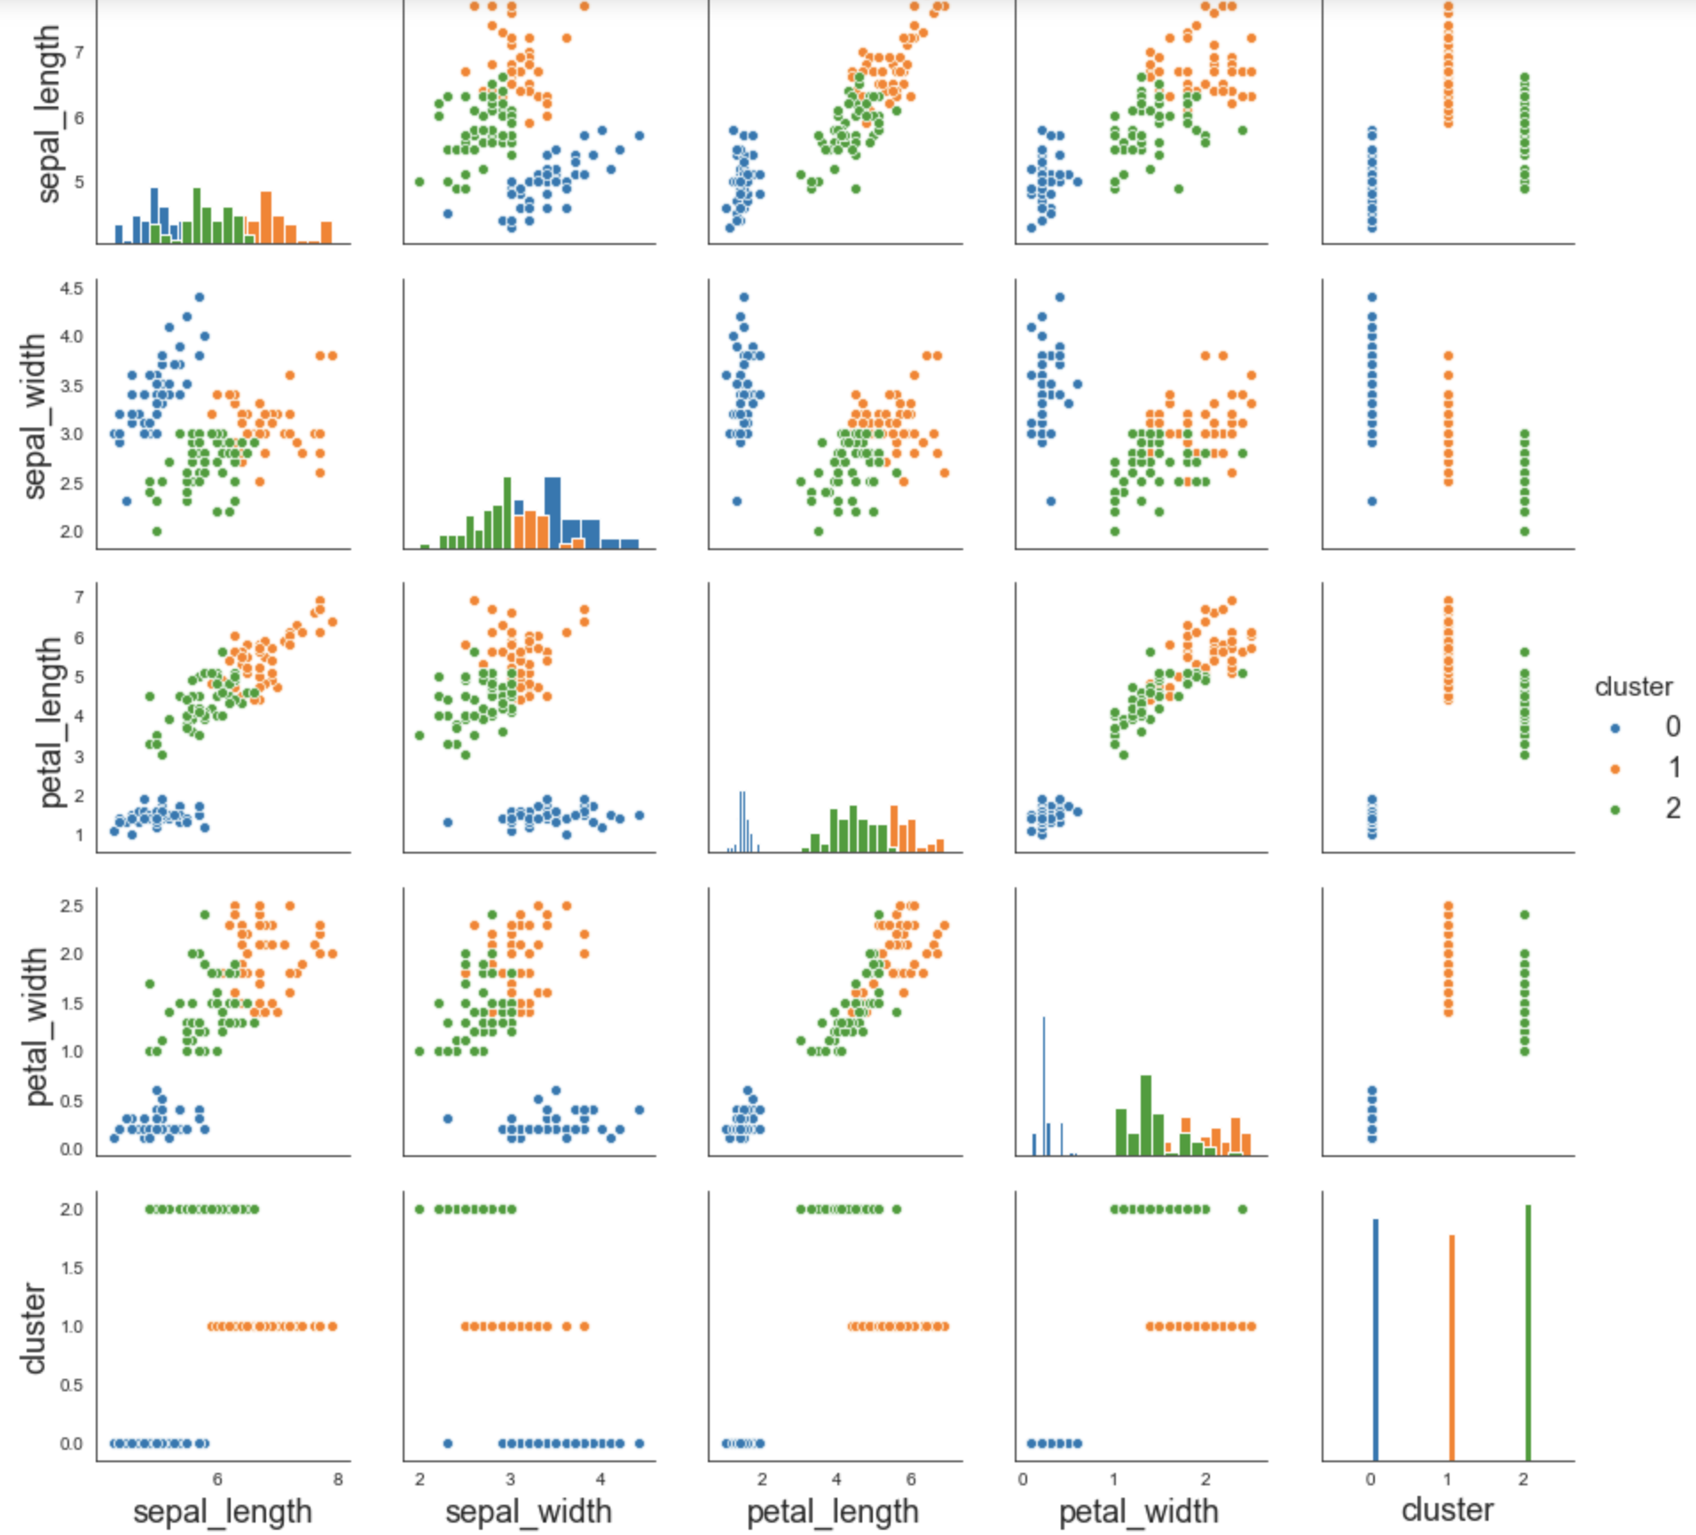
Explore Cluster Characteristics

Slide 9
Cluster Evaluation
Adjusted Rand Index
-1 to 1
Compare with true class
Silhouette
-1 to 1
Don't use true class
Compare distance to assigned center and next closest center

Slide 10
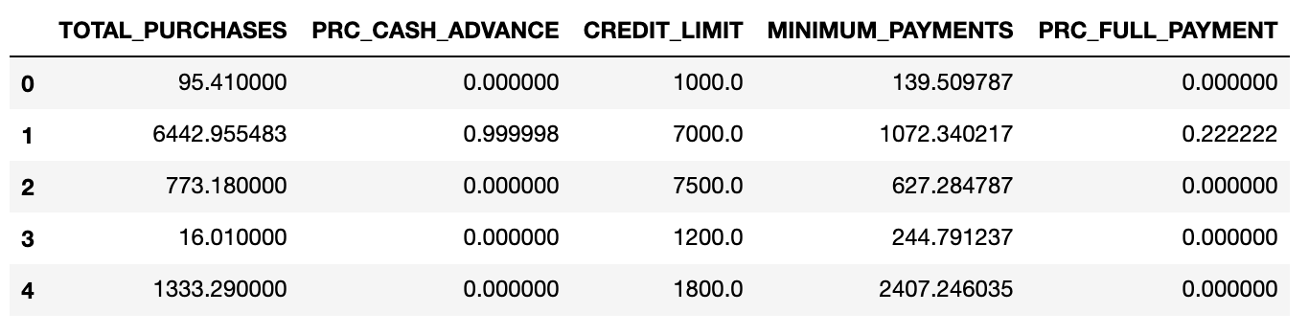
Lesson 2: K-means Case Stud
Credit Card Dataset

Slide 11
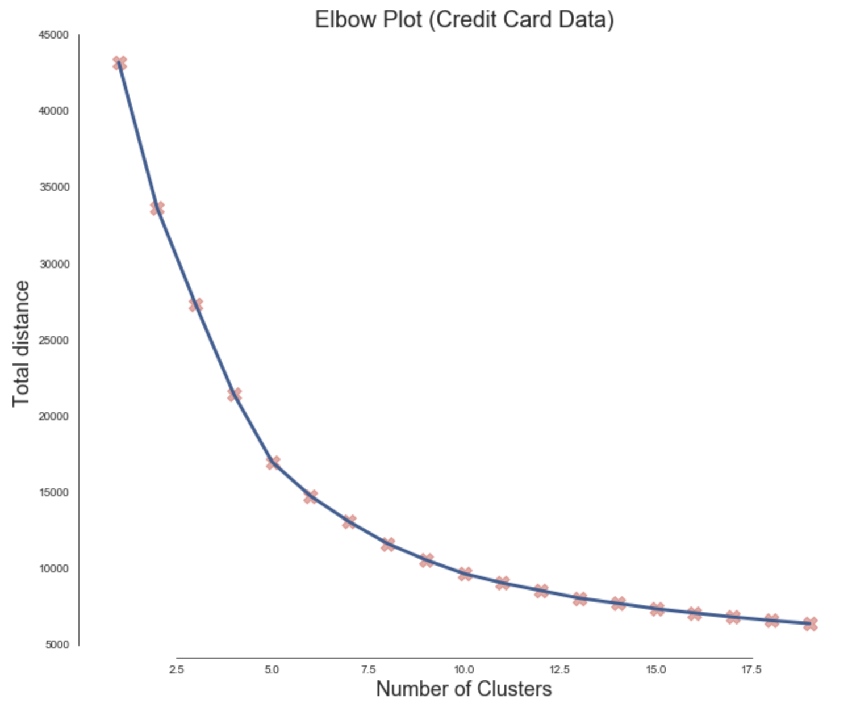
Determine K

Slide 12
Cluster Member Counts
Cluster 0 : 3436 members
Cluster 1 : 2572 members
Cluster 2 : 1270 members
Cluster 3 : 1233 members
Cluster 4 : 56 members
Cluster 5 : 69 members

Slide 13
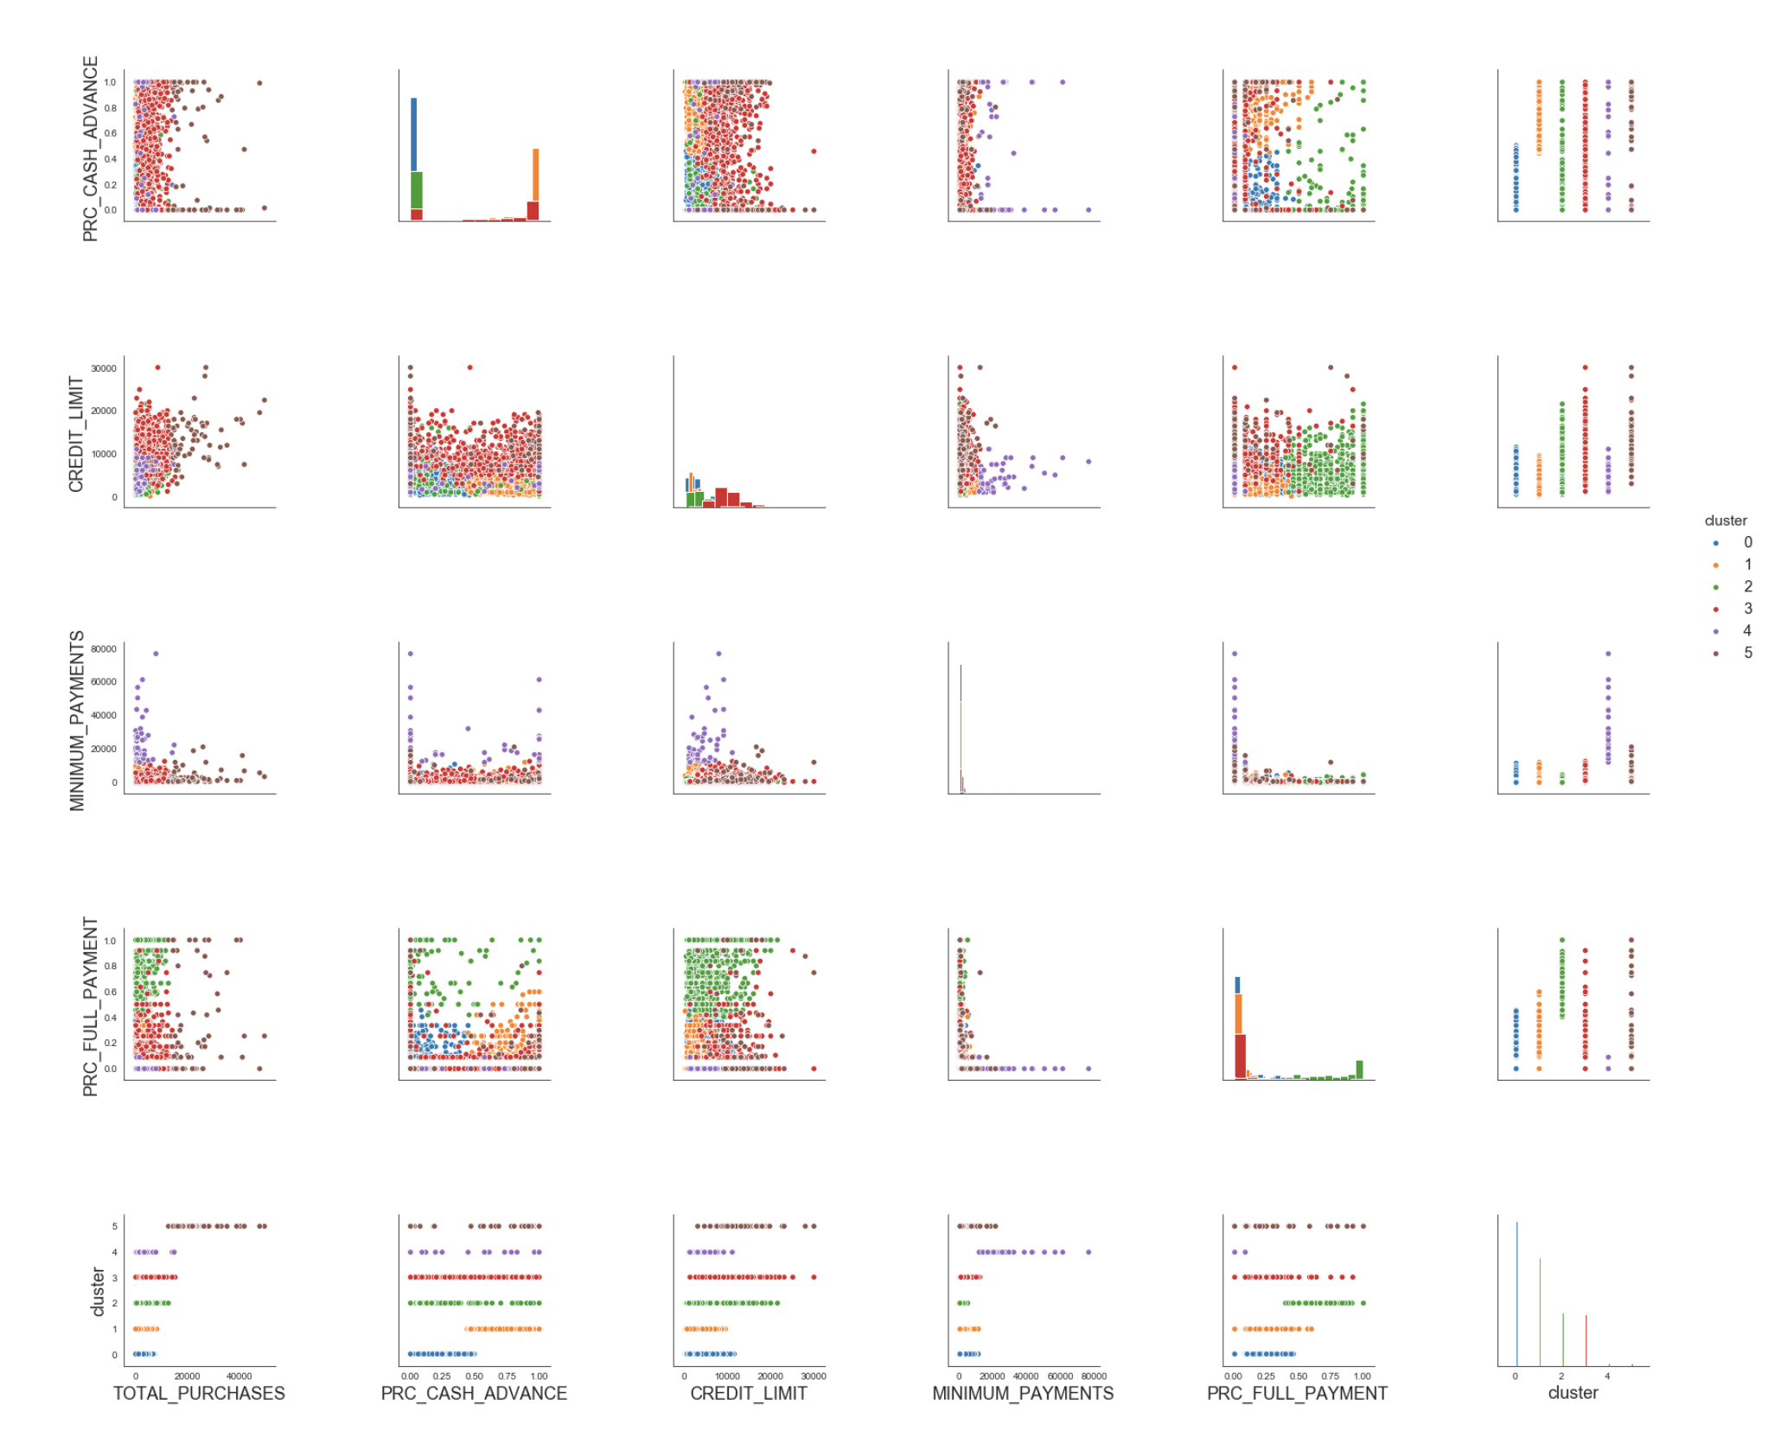
Explore Clusters

Slide 14
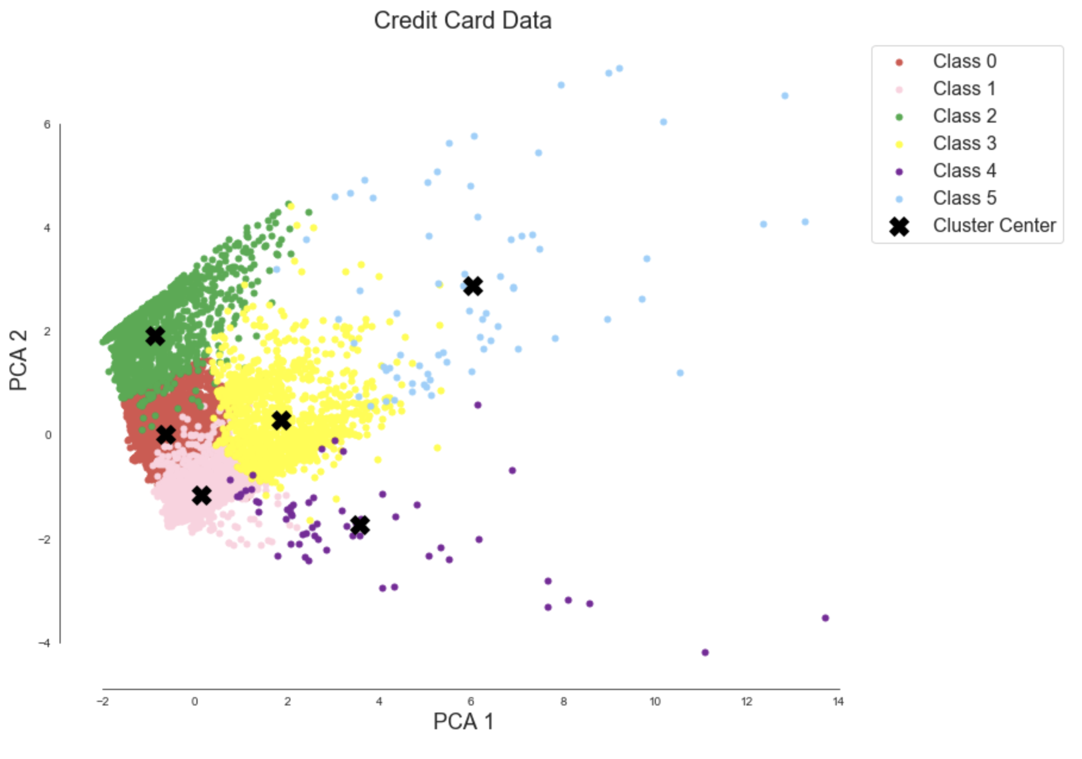
Visualize Data

Slide 15
Lesson 3: Introduction to Density-Based Clustering
DBSCAN
Scikit Learn DBSCAN Model
Hyperparameter Estimation
Kmeans vs. DBSCAN

Slide 16
DBSCAN
Hyperparameters
eps: Max distance between two points to be considered as in same neighbor
min_samples: Number of points that must lie within the neighborhood of the current point in order for it to be considered a core point.
Point Categories
Core point: at least min_samples of points within distance eps.
Border point: a core point, but within eps to at least one core point.
Noise point: Neither core point nor border point.
Clusters
All core points that are reachable to each other form a cluster. All border points of these core points also belong to the cluster.

Slide 17
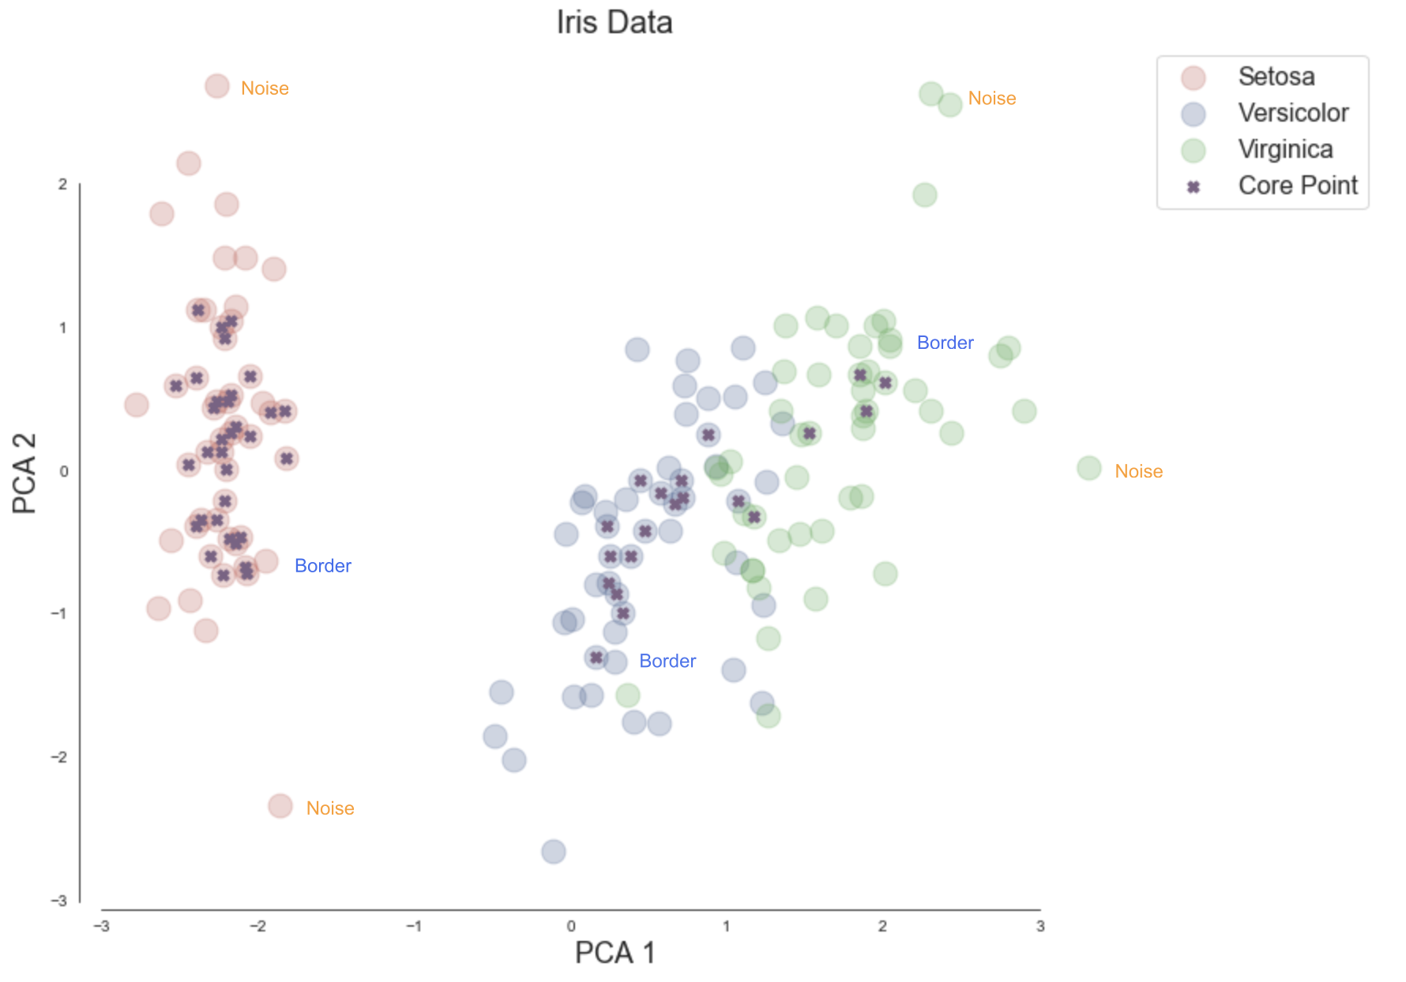
DBSCAN

Slide 18
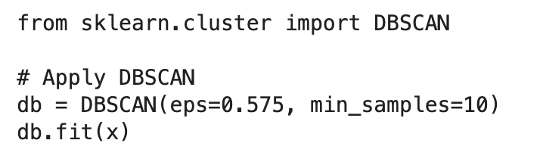
Scikit Learn DBSCAN Model

Slide 19
Hyperparameter Estimation
min_samples
Greater than number of features. ie. 2 times
eps
small eps preferable
k-distance graph

Slide 20
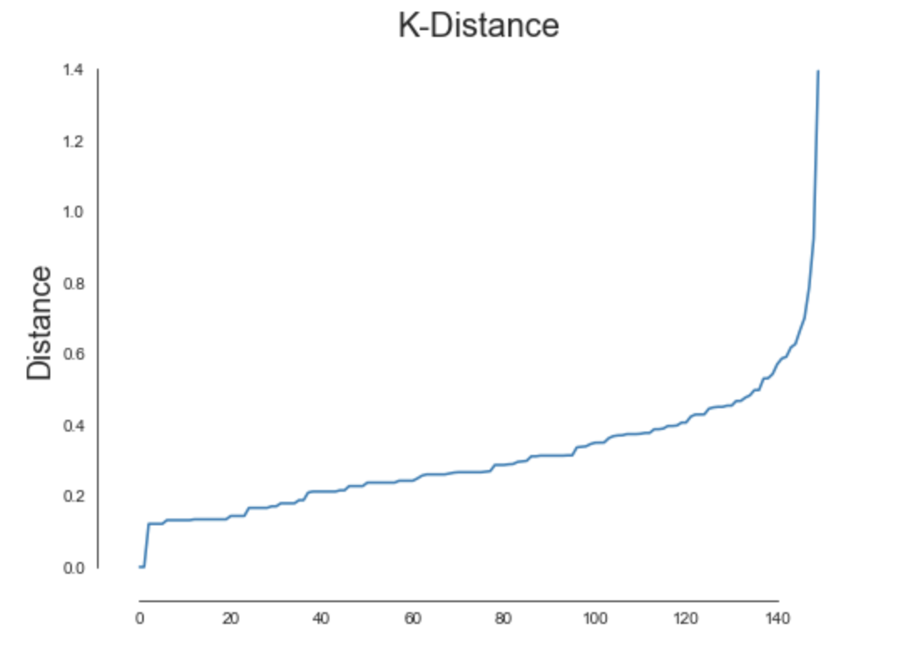
K-distance Graph
Plot distance to nearest neighbor for all data points
Choose a distance at elbow that covers majority of data points

Slide 21
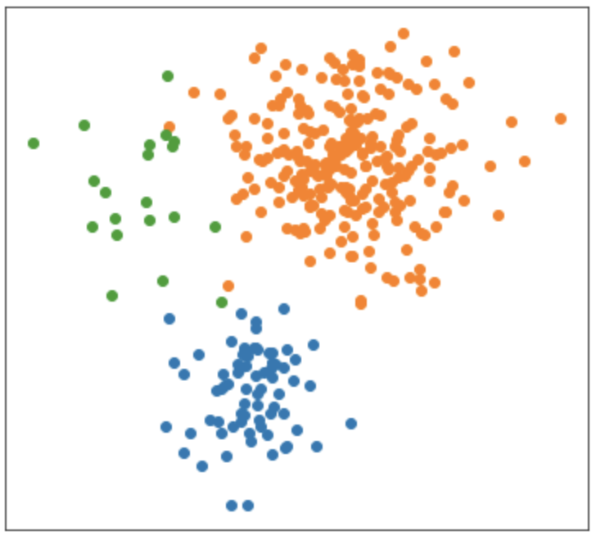
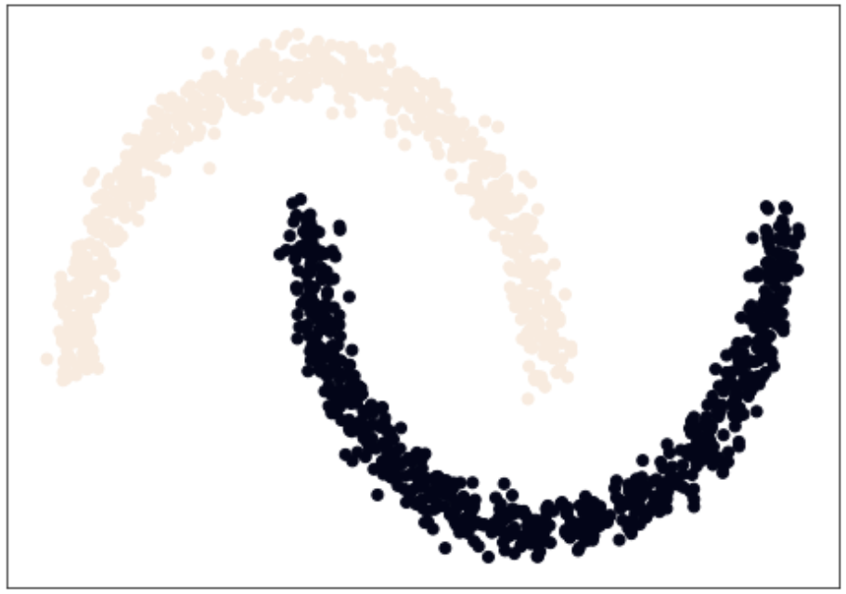
k-means vs. DBSCAN
k-Means works well:
K-means works poorly but DBSCAN works well:

